Slide 1
Chapter Four
Concurrency Control Techniques

Slide 2
Database Concurrency Control
Purpose of Concurrency Control
  To enforce isolation (through mutual exclusion) among conflicting transactions
  To preserve database consistency through consistency preserving execution of transactions
  To resolve read-write and write-write conflicts.
Example
  In concurrent execution environment if T1 conflicts with T2 over a data item A, then the existing concurrency control decides if T1 or T2 should get A and if the other transaction is rolled-back or waits
Therefor, to avoid concurrency related problems and to maintain consistency, some rules (protocols) need to be made so that system can be protected from such situations and increase the efficiency.
Notes:
To make system efficient and save time, it is required to execute more than one transaction at the same time.
But concurrency leads several problems(Lost Update Problem…).
Ayele G.

Slide 3
Database Concurrency Control
Two-Phase Locking Techniques
Two-phase locking protocol guarantees serializability
Locking is an operation which secures
    Permission to Read
    Permission to write a data item for a transaction
  Example:
  Lock (X): Data item X is locked in behalf of the requesting transaction
  Unlocking is an operation which removes these permissions from the data item
  Example:
    Unlock (X): Data item X is made available to all other transactions
    Lock and unlock are Atomic operations
Notes:
Indivisible(critical section in OS)-No interleaving should be allowed once a lock or unlock operation is started until the operation terminates
Ayele G.

Slide 4
Database Concurrency Control
Two-Phase Locking Techniques
Two locks modes:
    Shared (read)
    Exclusive (write)
  Shared mode - shared lock (X)
    More than one transaction can apply share lock on X for reading its value but no write lock can be applied on X by any other transaction
  Exclusive mode -Write lock (X)
    Only one write lock on X can exist at any time and no shared lock can be applied by any other transaction on X
Notes:
Ayele G.

Slide 5
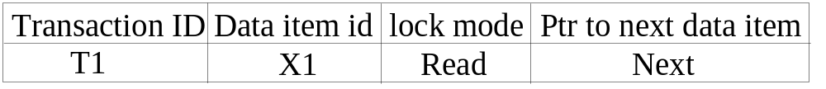
Database Concurrency Control
Two-Phase Locking Techniques
  Lock Manager:
  The DBMS has a lock manager subsystem to keep track of and control access to locks
  Managing locks on data items
  Lock Table:
    Lock manager uses a lock table to store the identify of transaction locking a data item, the data item lock mode and pointer to the next data item locked
Notes:
Ayele G.

Slide 6
Database Concurrency Control
Two-Phase Locking Techniques
Database requires that all transactions should be well-formed.
A transaction is well-formed if:
    A transaction T must issue the operation lock_item(X) before any read_item(X) or write_item(X) operations are performed in T
    A transaction T must issue the operation unlock_item(X) after all read_item(X) and write_item(X) operations are completed in T.
    A transaction T will not issue a lock_item(X) operation if it already holds the lock on item X
    A transaction T will not issue an unlock_item(X) operation unless it already holds the lock on item X
These rules can be enforced by the lock manager module of the DBMS
Notes:
Ayele G.

Slide 7
Database Concurrency Control
Two-Phase Locking Techniques
Lock conversion
To improve efficiency of two-phase locking protocol, modes of lock can be converted
Upgrade: Conversion of shared mode to exclusive mode is known as upgrade
Downgrade: Conversion of exclusive mode to shared mode is known as downgrade
In T5, an exclusive lock of A is needed after sometime so first obtain shared lock on A and then upgrade it
During this period any other transaction can also obtain shared lock of A and hence increase efficiency
Notes:
Ayele G.

Slide 8
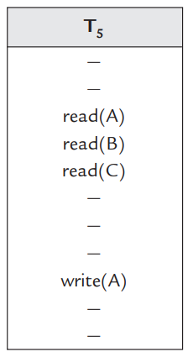
Database Concurrency Control
Two-Phase Locking Techniques
Lock conversion
In T5, an exclusive lock of A is needed after sometime so first obtain shared lock on A and then upgrade it
During this period any other transaction can also obtain shared lock of A and hence increase efficiency
Lock conversion (Upgrade)
Notes:
Ayele G.

Slide 9
Database Concurrency Control
Guaranteeing Serializability by Two-Phase Locking
Transaction is said to follow the two-phase locking protocol if all locking operations (read_lock, write_lock) precede the first unlock operation in the transaction
Such a transaction can be divided into two phases:
  An expanding or growing (first) phase, during which new locks on items can be acquired but none can be released; and
  A shrinking (second) phase, during which existing locks can be released but no new locks can be acquired
  If lock conversion is allowed, then upgrading of locks (from read-locked to write-locked) must be done during the expanding phase, and downgrading of locks (from write-locked to read-locked) must be done in the shrinking phase
Notes:
Ayele G.

Slide 10
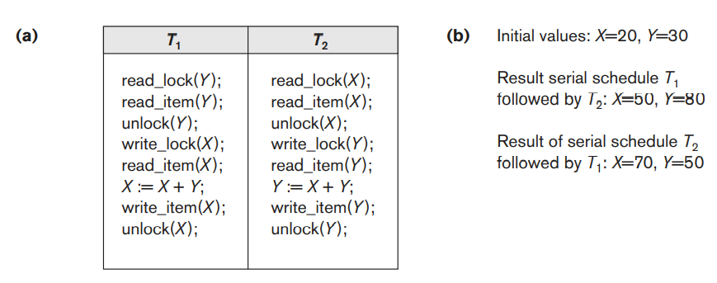
Database Concurrency Control
Notes:
Ayele G.

Slide 11
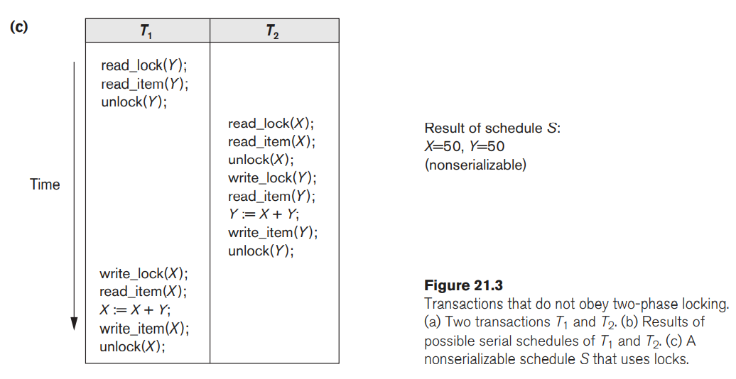
Database Concurrency Control
Notes:
Ayele G.

Slide 12
Database Concurrency Control
  T
Transactions T1 and T2 in Figure 21.3(a) do not follow the two-phase locking protocol because the write_lock(X) operation follows the unlock(Y) operation in T1, and similarly the write_lock(Y) operation follows the unlock(X) operation in T2
If we enforce two-phase locking, the transactions can be rewritten as T1′ and T2′, as shown in Figure 21.4.
Now, the schedule shown in Figure 21.3(c) is not permitted for T1′ and T2′ (with their modified order of locking and unlocking operations) under the rules of locking because T1′ will issue its write_lock(X) before it unlocks item Y; consequently, when T2′ issues its read_lock(X), it is forced to wait until T1′ releases the lock by issuing an unlock (X) in the schedules
However, this can lead to deadlock
Notes:
Ayele G.

Slide 13
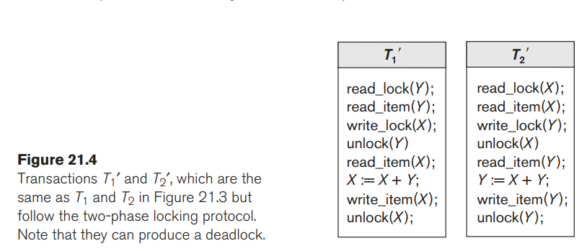
Database Concurrency Control
Notes:
Ayele G.

Slide 14

Database Concurrency Control
Dealing with Deadlock and Starvation
Deadlock occurs when each transaction T in a set of two or more transactions is waiting for some item that is locked by some other transaction T’ in the set
Notes:
Ayele G.

Slide 15
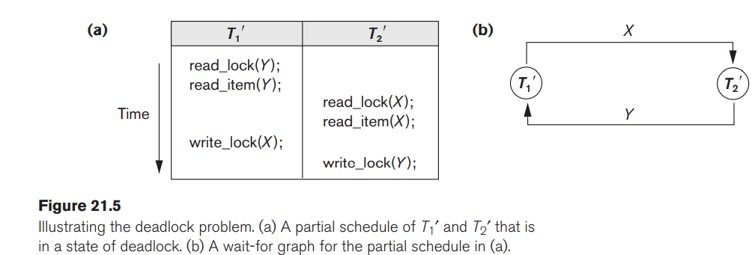
Database Concurrency Control
Dealing with Deadlock and Starvation
Deadlock occurs when each transaction T in a set of two or more transactions is waiting for some item that is locked by some other transaction T’ in the set
Notes:
Ayele G.

Slide 16
Database Concurrency Control
Dealing with Deadlock and Starvation
Deadlock…
For example: In the student table, transaction T1 holds a lock on some rows and needs to update some rows in the grade table. Simultaneously, transaction T2 holds locks on some rows in the grade table and needs to update the rows in the Student table held by Transaction T1.
Now, the main problem arises. Now Transaction T1 is waiting for T2 to release its lock and similarly, transaction T2 is waiting for T1 to release its lock. All activities come to a halt state and remain at a standstill. It will remain in a standstill until the DBMS detects the deadlock and aborts one of the transactions.
Notes:
Ayele G.

Slide 17
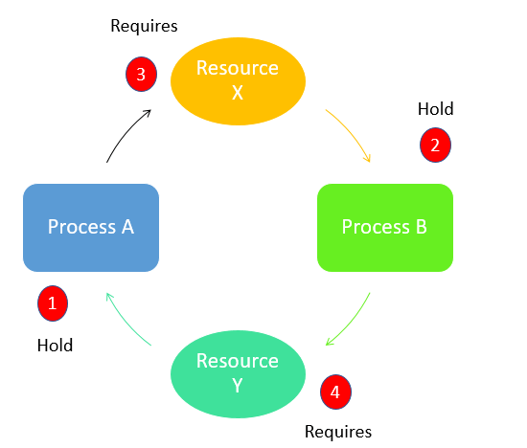
Database Concurrency Control
Dealing with Deadlock and Starvation
Deadlock…
Process A hold Y resource
Process B holds resource X
Process A require X resource
Process B require Y resource
Notes:
Ayele G.

Slide 18
Database Concurrency Control
Dealing with Deadlock and Starvation
Deadlock Prevention Protocols
  One way to prevent deadlock is use deadlock prevention protocol
    A transaction locks all data items it needs before it begins execution
    This way of locking prevents deadlock since a transaction never waits for a data item
    The conservative two-phase locking uses this approach
Notes:
Ayele G.

Slide 19
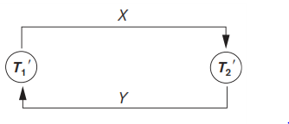
Database Concurrency Control
Dealing with Deadlock and Starvation
Deadlock Detection and Resolution
  The scheduler maintains a wait-for-graph for detecting cycle.
    If a cycle exists, then one transaction involved in the cycle is selected (victim) and rolled-back.
  A wait-for-graph is created using the lock table.
    As soon as a transaction is blocked, it is added to the graph.
    When a chain like: Ti waits for Tj waits for Tk waits for Ti or Tj occurs, then this creates a cycle
Notes:
Ayele G.

Slide 20
Database Concurrency Control
Dealing with Deadlock and Starvation
Deadlock Avoidance
  There are many variations of two-phase locking algorithm.
  Some avoid deadlock by not letting the cycle to complete.
  That is as soon as the algorithm discovers that blocking a transaction is likely to create a cycle, it rolls back the transaction
  Wound-Wait and Wait-Die algorithms use timestamps to avoid deadlocks by rolling-back victim
Notes:
Ayele G.

Slide 21
Database Concurrency Control
Dealing with Deadlock and Starvation
Deadlock avoidance
Wait-die: If TS(Ti) < TS(Tj), then (Ti older than Tj) Ti is allowed to wait; otherwise (Ti younger than Tj ) abort Ti (Ti dies) and restart it later with the same timestamp
  Older transaction is allowed to wait for a younger transaction, whereas a younger transaction requesting an item held by an older transaction is aborted and restarted
Wound-Wait: If TS(Ti) < TS(Tj ), then (Ti older than Tj ) abort Tj (Ti wounds Tj ) and restart it later with the same timestamp; otherwise (Ti younger than Tj ) Ti is allowed to wait
  A younger transaction is allowed to wait for an older one, whereas an older transaction requesting an item held by a younger transaction preempts the younger transaction by aborting it
Notes:
Ayele G.

Slide 22
Database Concurrency Control
Dealing with Deadlock and Starvation
Starvation
  Starvation occurs when a particular transaction consistently waits or restarted and never gets a chance to proceed further.
  This limitation is inherent in all priority based scheduling mechanisms.
  One solution for starvation is to have a fair waiting scheme, such as using a first-come-first-served queue
  In Wound-Wait scheme a younger transaction may always be wounded (aborted) by a long running older transaction which may create starvation
Notes:
Ayele G.

Slide 23
Database Concurrency Control
Timestamp based Concurrency Control Algorithm
Timestamp
  Timestamp is a unique identifier created by the DBMS to identify a transaction
    A larger timestamp value indicates a more recent event or operation.
  Timestamp values are assigned in the order in which the transactions are submitted to the system, so a timestamp can be thought of as the transaction start time.
    We will refer to the timestamp of transaction T as TS(T)
  Timestamp based algorithm uses timestamp to serialize the execution of concurrent transactions.
  Concurrency control techniques based on timestamp ordering do not use locks; hence, deadlocks cannot occur
Notes:
Ayele G.

Slide 24
Database Concurrency Control
Timestamp based Concurrency Control Algorithm
Timestamp
Two Timestamp (TS) Values:
read_TS(X):The read timestamp of item X is the largest timestamp among all the timestamps of transactions that have successfully read item X—that is, read_TS(X) = TS(T), where T is the youngest transaction that has read X successfully.
write_TS(X):The write timestamp of item X is the largest of all the timestamps of transactions that have successfully written item X-that is, write_TS(X) = TS(T), where T is the youngest transaction that has written X successfully. Based on the algorithm, T will also be the last transaction to write item X.
Notes:
Ayele G.

Slide 25
Database Concurrency Control
Timestamp based Concurrency Control Algorithm
Basic Timestamp Ordering
The concurrency control algorithm must check whether conflicting operations violate the timestamp ordering in the following two cases:
  1. Tansaction T issues a write_item(X) operation:
    If read_TS(X) > TS(T) or if write_TS(X) > TS(T), then a younger transaction has already read the data item so abort and roll-back T and reject the operation.
    If the condition in part (a) does not exist, then execute write_item(X) of T and set write_TS(X) to TS(T)
  2. Transaction T issues a read_item(X) operation:
    If write_TS(X) > TS(T), then a younger transaction has already written to the data item so abort and roll-back T and reject the operation
    If write_TS(X) ≤ TS(T), then execute read_item(X) of T and set read_TS(X) to the larger of TS(T) and the current read_TS(X)
Notes:
Ayele G.

Slide 26
Database Concurrency Control
Timestamp based Concurrency Control Algorithm
Strict Timestamp Ordering
  Transaction T issues a write_item(X) and read_item(X) operation:
    If TS(T) > read_TS(X), then delay T until the transaction T’ that wrote or read X has terminated (committed or aborted).
Notes:
Ayele G.

Slide 27
Database Concurrency Control
Timestamp based concurrency control algorithm
Thomas’s Write Rule
Modification of basic TO algorithm, known as Thomas’s write rule
  If read_TS(X) > TS(T) then abort and roll-back T and reject the operation
  If write_TS(X) > TS(T), then just ignore the write operation and continue execution. This is because some transaction with timestamp greater than TS(T) and hence after T in the timestamp ordering has already written the value of X
  If the conditions given in 1 and 2 above do not occur, then execute write_item(X) of T and set write_TS(X) to TS(T)
Notes:
Ayele G.

Slide 28
Database Concurrency Control
Multiversion Concurrency Control Techniques
Other protocols for concurrency control keep the old values of a data item when the item is updated
This approach maintains a number of versions of a data item and allocates the right version to a read operation of a transaction.
Thus unlike other mechanisms a read operation in this mechanism is never rejected
Disadvantage
    Significantly more storage (RAM and disk) is required to maintain multiple versions
Notes:
Ayele G.

Slide 29
Database Concurrency Control
Multiversion Technique based on Timestamp Ordering
Assume X1, X2, …, Xn are the version of a data item X created by a write operation of transactions.
With each Xi a read_TS (read timestamp) and a write_TS (write timestamp) are associated.
  read_TS(Xi): The read timestamp of Xi is the largest of all the timestamps of transactions that have successfully read version Xi.
  write_TS(Xi): The write timestamp of Xi that wrote the value of version Xi.
  A new version of Xi is created only by a write operation.
Notes:
Ayele G.

Slide 30
Database Concurrency Control
Multiversion Technique based on Timestamp Ordering
To ensure serializability, the following two rules are used
  If transaction T issues write_item (X) and version i of X has the highest write_TS(Xi) of all versions of X that is also less than or equal to TS(T), and read _TS(Xi) > TS(T), then abort and roll-back T; otherwise create a new version Xi and read_TS(Xj) = write_TS(Xj) = TS(T)
  If transaction T issues read_item (X), find the version i of X that has the highest write_TS(Xi) of all versions of X that is also less than or equal to TS(T), then return the value of Xi to T, and set the value of read _TS(Xi) to the largest of TS(T) and the current read_TS(Xi).
Notes:
Ayele G.

Slide 31
Database Concurrency Control
Validation (Optimistic) Concurrency Control Scheme
In this technique only at the time of commit serializability is checked and transactions are aborted in case of non-serializable schedules.
Three phases:
  Read Phase
  Validation Phase
  Write Phase
1. Read Phase :
A transaction can read values of committed data items. However, updates are applied only to local copies (versions) of the data items (in database cache)
Notes:
Ayele G.

Slide 32
Database Concurrency Control
Validation (Optimistic) Concurrency Control Schemes
2. Validation phase: Serializability is checked before transactions write their updates to the database
  The validation phase for Ti checks that, for each such transaction Tj that is either recently committed or is in its validation phase, one of the following conditions holds:
    Tj completes its write phase before Ti starts its read phase.
    Ti starts its write phase after Tj completes its write phase, and the read_set of Ti has no items in common with the write_set of Tj
    Both the read_set and write_set of Ti have no items in common with the write_set of Tj, and Tj completes its read phase before Ti completes its read phase.
When validating Ti, the first condition is checked first for each transaction Tj, since (1) is the simplest condition to check. If (1) is false then (2) is checked and if (2) is false then (3 ) is checked. If none of these conditions holds, the validation fails and Ti is aborted.
Notes:
Ayele G.

Slide 33
Database Concurrency Control
Validation (Optimistic) Concurrency Control Schemes
Recall that the write_set of a transaction is the set of items it writes, and the read_set is the set of items it reads
3. Write phase: On a successful validation transactions’ updates are applied to the database; otherwise, transactions are restarted.
Notes:
Ayele G.

Slide 34
Database Concurrency Control
Granularity of Data Items and Multiple Granularity Locking
Granularity can be coarse (entire database) or it can be fine (a tuple or an attribute of a relation)
Fine granularity refers to small item sizes, where as coarse granularity refers to large item sizes
Data item granularity significantly affects concurrency control performance. Thus, the degree of concurrency is low for coarse granularity and high for fine granularity.
Example of data item granularity:
  A field of a database record (an attribute of a tuple)
  A database record (a tuple or a relation)
  A disk block
  An entire file
  The entire database
Notes:
Ayele G.

Slide 35
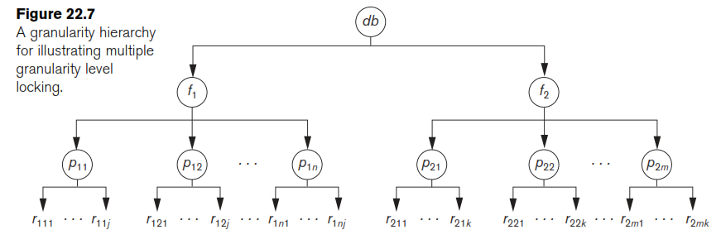
Database Concurrency Control
Granularity of Data Items and Multiple Granularity Locking
The following diagram illustrates a hierarchy of granularity from coarse (database) to fine (record) granularity
Notes:
Ayele G.

Slide 36
Database Concurrency Control
Granularity of Data Items and Multiple Granularity Locking
To manage such hierarchy, in addition to read and write, three additional locking modes, called intention lock modes are defined:
  Intention-shared (IS): Indicates that a shared lock(s) will be requested on some descendent nodes(s)
  Intention-exclusive (IX): Indicates that an exclusive lock(s) will be requested on some descendent node(s)
  Shared-intention-exclusive (SIX): Indicates that the current node is locked in shared mode but an exclusive lock(s) will be requested on some descendent nodes(s)
Notes:
Ayele G.

Slide 37
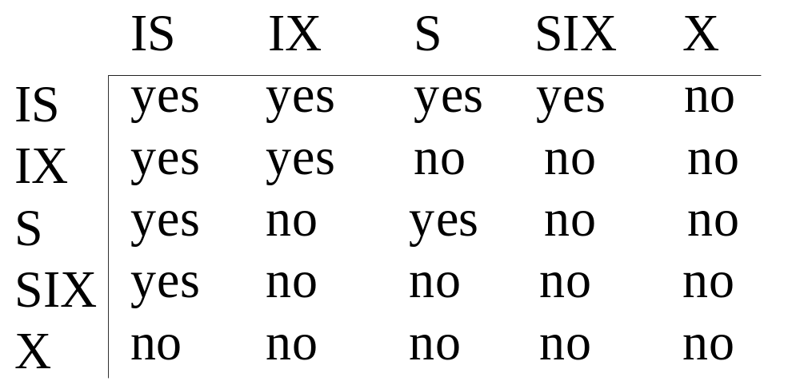
Database Concurrency Control
Granularity of Data Items and Multiple Granularity Locking
These locks are applied using the following compatibility matrix:
  Intention-shared (IS)
  Intention-exclusive (IX)
  Shared-intention-exclusive (SIX)
Figure 21.8: Lock compatibility matrix for multiple granularity locking
Notes:
Ayele G.

Slide 38
Database Concurrency Control
Granularity of Data Items and Multiple Granularity Locking
The multiple granularity locking (MGL) protocol consists of the following rules
  The set of rules which must be followed for producing serializable schedule are
    The lock compatibility matrix must be adhered to (on figure 21.8)
    The root of the tree must be locked first, in any mode
    A node N can be locked by a transaction T in S or IX mode only if the parent node is already locked by T in either IS or IX mode
    A node N can be locked by T in X, IX, or SIX mode only if the parent of N is already locked by T in either IX or SIX mode
    T can lock a node only if it has not unlocked any node (to enforce 2PL policy).
    T can unlock a node, N, only if none of the children of N are currently locked by T
Notes:
Ayele G.

Slide 39
Database Concurrency Control
Reading Assignment
Using Locks for Concurrency Control in Indexes
Notes:
Ayele G.

Slide 40
?

